Slide 1
Chapter 3 Linear Search Methods
  One-dimensional (1-D) search methods, a. k. a. linear search methods, are the fundamental algorithms in the optimization theory. Basically, all the nonlinear algorithms can be attributed to the linear searches along a sequence of generated descent directions.
  For f(X) with multiple variables, starting from X_{k}, the 1-D search along the direction S_{k} can be expressed as:
  min f (X_{k} + αS_{k}) = f (X_{k} + α_{k}S_{k})
  X_{k+1} = X_{k} + α_{k}S_{k}
  which represents the minimization of f (X_{k} + αS_{k}) w.r.t. single variable α. The optimal step length α_{k} and then the minimum point X_{k+1} along S_{k} can be obtained.

Slide 2
One-dimensional Search Methods
  1-D search is actually an iteration algorithm for minimization of functions with single variable. It can be simply written as:
  min f(α)
  or in a more general form as:
  min f(x)
  The algorithm for 1-D search consists of two steps:
  1) an initial internal including the minimum point needs to be determined.
  2) then the length of the interval is reduced after every iteration until the minimum point is found.

Slide 3
3.1 Determination of Initial Interval
  Unimodal Function:
  A function f of single variable x on an interval [a, b] is said to be unimodal if it has only one local minimum point in this interval.
  On the left side of the minimum point, the function values decrease monotonically;
  On the right side of the minimum point, the function values increase monotonically.
  See the illustration graphs:

Slide 4
3.1 Determining Initial Interval (II)
  Assuming f(x) is a unimodal function on the search interval, if three adjacent points x₁ < x₂ < x₃ and their function values f(x₁), f(x₂), f(x₃) are known, then the location of the minimum point can be determined by comparing these three function values.
  The graphs are illustrated as follows:
  1) if f(x₁) > f(x₂) > f(x₃), the minimum point is located on the right hand side of x₂.
  2) if f(x₁) < f(x₂) < f(x₃), the minimum point is located on the left hand side of x₂.
  3) if f(x₁) > f(x₂) < f(x₃), the minimum point is located between x₁ and x₃. [x₁, x₃] is the initial search interval.

Slide 5
3.1 Determining Initial Interval (III)
  With the algorithm, a sequence of searching points can be generated along some direction.
  By comparing the function values at these searching points, three points can be found to form a convex function by connecting these three points. The interval comprised of these three points must include the minimum point. This interval is called the Initial Search Interval, denoted as [a, b].
  The search interval is also referred to as Interval of Uncertainty (IU).

Slide 6
3.1 Determining Initial Interval (IV)
  Basic steps for determining the initial interval:
  1. Given an initial estimate of the minimum point, x₀, an initial step length h; Set x₁=x₀, denote f₁=f(x₁);
  2. Let x₂=x₀+h, denote f₂ = f(x₂);
  3. Compare the values of f₁ and f₂ to decide the search direction (forward or backward):
  i) If f₁ > f₂, then double the step length by setting h=2h, go to step 4 and search forward;
  ii) If f₁ < f₂, then change the search direction by setting h = -h, switch x₁ and x₂ as well as the function values f₁ and f₂; go to step 4 and search backward;

Slide 7
3.1 Determining Initial Interval (V)
  4. Let x₃=x₀+h, denote f₃ = f(x₃);
  5. Comparing the values of f₂ and f₃:
  i) If f₂ < f₃, then the initial interval is found as [x₁, x₃];
  ii) If f₂ > f₃, then increase the step length by setting h=2h, x₁=x₂, x₂=x₃, go to step 4 and keep searching.
  During the process of determining the initial interval, the initial step length should be chosen appropriately. In general, the initial step length is set as h=1.0.

Slide 8
3.2 Shortening the Search Interval
  1-D search is an algorithm to obtain the minimum point by iteratively shortening the search interval (also called Interval of Uncertainty) along a given direction.
  The basic strategy of shortening the interval of uncertainty can be described as follows:
  Interpolate two points inside the current known interval; By comparing the function values at these two points, a smaller interval of uncertainty with the minimum point inside can be identified.

Slide 9
3.2 Shortening the Interval (II)
  e.g., on a current interval of [a, b], arbitrarily choose two interpolation points x₁ and x₂:
  if f(x₁) < f(x₂), then the new search interval is [a, x₂];
  if f(x₁) > f(x₂), the new search interval becomes [x₁, b];
  if f(x₁) = f(x₂), then the new search interval is [x₁, x₂].
  Repeat the above process, the interval of uncertainty can be shortened gradually.
  When |b_{n}-a_{n}|≤ε, or |x_{n+1}-x_{n}|≤ε, the given convergence accuracy, some point inside this interval can be approximately considered as the minimum point along this search direction.

Slide 10
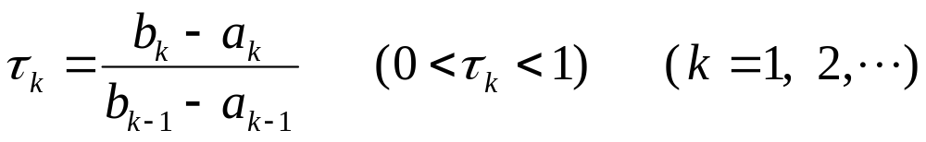
3.2 Shortening the Interval (III)
  Any two interpolation points can shorten the search interval once. Different ways of generating these interpolation points construct different 1-D search algorithms, and consequently different ratio of reduction of the interval length.
  Ratio of Interval Reduction is defined as the ratio between the length of current interval and previous search interval:

Slide 11
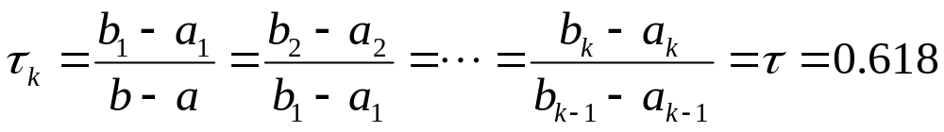
3.3 Golden Section Method (GSM)
  Golden Section Method, a.k.a. the 0.618 Method, is a 1-D search method choosing the interpolation points via the Symmetry Principle.
  The ratio of interval reduction is a constant, which can be deducted to be the Golden Section Number, i.e., 0.618. This is the way this search method is named.
  The deduction of the ratio of interval reduction is presented here:

Slide 12
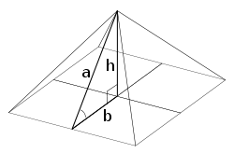
Facts of Gold Section Number
Most Perfect Body:
Distance from navel to the bottom of the foot : Height = 0.618
Most Beautiful Face:
Distance from eyebrow to neck : distance from top of head to neck = 0.618
Most Comfortable Temperature:
0.618 * Body Temperature (37°C) = 23°C
Egyptian Pyramid:
b:a = 0.618

Slide 13
3.3 GSM (II)
  The iteration formula of the Golden Section Method (GSM) can be expressed as:
  x₁ = a + 0.382(b-a)
  x₂ = a + 0.618(b-a)
  where, [a, b] represents the current search interval.
  Convergence Judgement: when b_{n} – a_{n} ≤ ε , the convergence accuracy, the algorithm is said to be converged. Then the middle point of that interval is considered as the approximation of the minimum point, i.e., the minimum point is chosen as:
  x* = (b_{n} + a_{n})/2

Slide 14
3.3 GSM (III)
  Given the convergence accuracy ε and the initial search interval [a, b], then the iteration times n to achieve the convergence can be determined as:
  0.618^{n}(b-a) ≤ ε
  ⇒ n ≥ ln[ε/(b-a)] ∕ ln(0.618)
  Therefore, the smaller the convergence accuracy ε is, or the larger the length of the interval b-a is, more iterations n are needed to get the algorithm converged.

Slide 15
3.3 GSM (IV) - Algorithm
  The algorithm of the GSM:
  1. Initial search interval [a₀, b₀] and the convergence accuracy ε are given;
  2. let a=a₀, b=b₀;
  3. The interpolation points are generated by GSM, the function values are also computed:
  x₁ = a + 0.382(b-a) f₁ = f(x₁)
  x₂ = a + 0.618(b-a) f₂ = f(x₂)
  4. Compare f₁ and f₂ to determine the new interval:
  a) if f₁ < f₂, then the new search interval is [a, x₂]; let b = x₂, x₂ = x₁, f₂ = f₁ and denote N₁ = 0;

Slide 16
3.3 GSM - Algorithm (Cont’d)
  b) if f₁ > f₂, then the new search interval is [x₁, b]; let a = x₁, x₁ = x₂, f₁ = f₂ and denote N₁ = 1;
  5. Convergence judgement: when b-a ≤ ε is satisfied, the algorithm is terminated and the minimum point is x* = (b+a)/2; otherwise go to step 6;
  6. Generate new interpolation points:
  if N₀ = 0, set x₁ = a + 0.382(b-a), f₁ = f (x₁);
  if N₀ = 1, set x₂ = a + 0.618(b-a), f₂ = f (x₂);
  go to step 4 to continue the search.

Slide 17
3.3 Example for GSM
Example 3-1:
Determine the minimum point of f(x)=3x³-4x+2 using the Golden Section Method, given x₀=0, h=1, ε=0.2.
Sol: (1) (0, 2), (1, 1), (2, 18) ⇒ IU is (0, 2)
(2) 1st: (0.764, 0.282), (1.236, 2.72) ⇒ (0, 1.236)
2nd: (0.472, 0.317) ⇒ (0.472, 1.236)
3rd: (0.944, 0.747) ⇒ (0.472, 0.944)
4th: (0.652, 0.223) ⇒ (0.472, 0.764)
5th: (0.584, 0.262) ⇒ (0.584, 0.764) ⇒ b_{n} – a_{n} = 0.18 < ε = 0.2
⇒ x* = (b_{n} + a_{n} )/2 = 0.674 ⇒ f(x*) = f(0.674) = 0.222

Slide 18
3.4 Fibonacci Search Method (FSM)
  Similar to GSM, the Fibonacci Method (FSM) is also a 1-D search method shortening the search interval by choosing the interpolation points via the Symmetry Principle.
  FSM is derived based on the Fibonacci numbers. The ratio of interval reduction τ can be expressed as:
  τ_{k} = F_{n-k} / F_{n-k+1} (n is a pre-determined integer)
  where the Fibonacci sequence {F_{k}} is generated as:
  F₀ = F₁ = 1
  F_{k} = F_{k-1} + F_{k-2} k = 2, 3, …

Slide 19
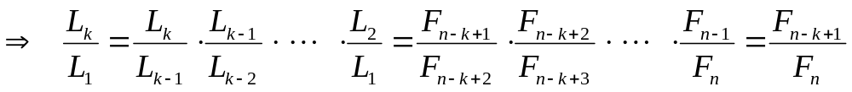
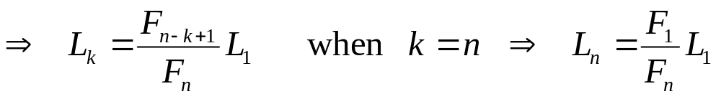
3.4 FSM (II)
  Procedures of the Fibonacci algorithm:
  Step 1 (k=1) : τ₁ = F_{n-1} / F_{n} = L₂ / L₁
  Step k : τ_{k} = F_{n-k} / F_{n-k+1} = L_{k+1} / L_{k}
  How to determine n?
  Given the initial search interval [a, b] and the convergence accuracy ε > 0, then:
  L_{n}= (F₁/F_{n})L₁ = (b-a)/F_{n} ≤ ε ⇒ F_{n} ≥ (b-a)/ε ⇒ n

Slide 20
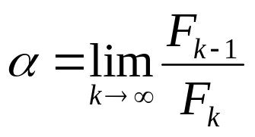
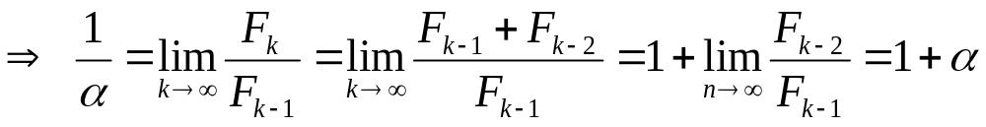
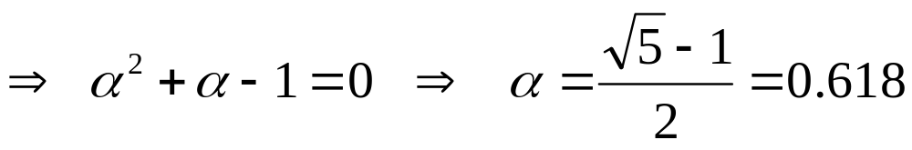
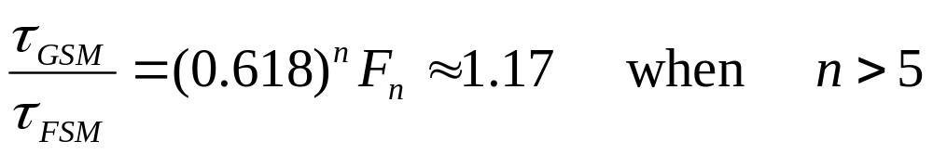
3.4 FSM (III) - Further Discussion
  Assuming that the ratio of two consecutive Fibonacci numbers, F_{k−1}/F_{k}, converges to a finite limit α, then:
  Interval Reduction Ratio:
  ⇒ FSM is approximately 17% better than GSM in interval reduction. Disadvantage is that the total number of iterations n needs to be determined before starting the search.

Slide 21
3.4 Example for FSM
Example 3-2:
Determine the minimum point of f(x) = 3x³ - 4x + 2 using FSM, given x₀ = 0, h = 1, ε = 0.2.
Sol: (1) (0, 2), (1, 1), (2, 18) ⇒ IU is (0, 2)
(2) F_{n} ≥ (b-a)/ε = 10 ⇒ n = 6 ⇒ τ = F₅/F₆ = 8/13 ⇒ L₂ = 16/13
1st: f₁ = f(10/13) = 0.288 < f₂ = f(16/13) = 2.672 ⇒ (0, 16/13)
2nd: f₁ = f(6/13) = 0.448 > f₂ = f(10/13) = 0.288 ⇒ (6/13, 16/13)
3rd: f₁ = f(10/13) = 0.288 < f₂ = f(12/13) = 0.671 ⇒ (6/13, 12/13)
4th: f₁ = f(8/13) = 0.237 < f₂ = f(10/13) = 0.288 ⇒ (6/13, 10/13)
5th: x₁ = x₂ = 8/13 ⇒ x* = 8/13 ⇒ f* = f(8/13) = 0.237

Slide 22
3.5 Powell’s
Quadratic Interpolation Method
  Powell’s Quadratic Interpolation Method, is also called the parabolic method, is another 1-D search method. It choose the minimum point of the quadratic interpolation function as the new interpolation point to shorten the search interval.
  The interpolation curve is formed by connecting several known points, the function represented by this curve is called the interpolation function.
  The interpolation methods include the polynomial interpolation, the sample interpolation, etc.

Slide 23
3.5 Powell’s QIM (II)
  The polynomial interpolations mainly consist of linear, quadratic and cubic interpolations, where the Quadratic Interpolation is mostly used.
  As described before, the initial search interval is a closed interval comprised by three points which comprise a convex function. Assume these points are a<c<b, with the function values f_{a} > f_{c} < f_{b}.
  Denote x₁=a, x₂=c, x₃=b and f₁=f_{a}, f₂=f_{c}, f₃=f_{b}, where f₁ > f₂ < f₃. Thus, three points (x₁, f₁), (x₂, f₂), (x₃, f₃) can be acquired in the coordinate plane.

Slide 24
3.5 Powell’s QIM (III)
  A quadratic (parabolic) curve can be obtained by connecting these three points. The corresponding interpolation function can be expressed:
  p(x) = α₂x² + α₁x + α₀
  The minimum point of this function, x_{p}, can be determined by taking the derivative of p(x) with respect to x. It can be written as:
  x_{p} = -α₁/2α₂
  In order to make sure x_{p} is the minimum point, should have d²p/dx² = 2α₂ > 0 .

Slide 25
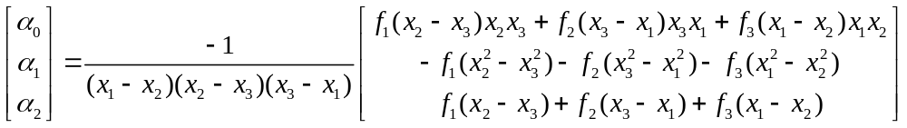
3.5 Powell’s QIM (IV)
  Plug in x₁, x₂, x₃ and f₁, f₂, f₃ to get:
  f₁ = α₂x₁² + α₁x₁ + α₀
  f₂ = α₂x₂² + α₁x₂ + α₀
  f₃ = α₂x₃² + α₁x₃ + α₀
  Solve these three equations for α₀, α₁, α₂:

Slide 26
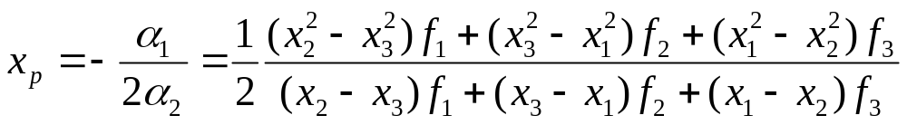
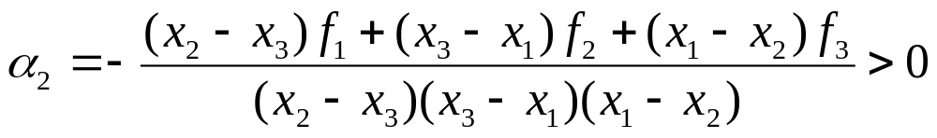
3.5 Powell’s QIM (IV)
  Then x_{p} can be expressed as:
  To ensure x_{p} is the minimum point, it should have:
  d²p/dx² = 2α₂ > 0 ⇒ α₂ > 0

Slide 27
3.5 Powell’s QIM (V)
  It can be seen that x_{p} is the minimum point of the interpolation function, but also an approximate minimum point of the original objective function. Use this point as the interpolation point for next search interval will definitely accerlate the shortening of the search interval.
  Convergence Criterion of QIM:
  when |x₂ - x_{p}| ≤ ε, the algorithm can be terminated, and the one with the smaller function value between x₂ and x_{p} is considered as the minimum point.

Slide 28
3.5 Algorithm for Powell’s QIM
  Algorithm procedures for QIM:
  1. Given the initial estimate x₀, initial step length h and convergence accuracy ε > 0;
  2. Determine initial search interval [a, b] and another point c inside this interval；
  3. Let x₁=a < x₂=c < x₃=b and f₁=f(x₁) > f₂=f(x₂) < f₃=f(x₃);
  4. Calculate the interpolation point x_{p} and f_{p}=f(x_{p});
  5. Convergence Judgement: if |x₂-x_{p}| ≤ ε, then the search can be terminated and the minimum point is found. Otherwise go to step 6;

Slide 29
3.5 Algorithm for QIM (Cont’d)
  6. Shortening the search interval with consideration of the following cases:
  i) x_{p} ≤ x₂, f_{p} ≤ f₂, new IU is [x₁, x₂] having x_{p};
  ii) x_{p} ≤ x₂, f_{p} > f₂, new IU is [x_{p}, x₃] including x₂;
  ii) x_{p} > x₂, f_{p} ≤ f₂, new IU is [x₂, x₃] holding x_{p};
  iv) x_{p} > x₂, f_{p} > f₂, new IU is [x₁, x_{p}] containing x₂.
  7. Go to step 4 and search for new interpolation point.

Slide 30
3.5 Examples for Powell’s QIM
Ex 3-3: Determine the minimum point of f(x)=3x³-4x+2 through QIM, given x₀ = 0, h = 1, ε = 0.2.
Sol: (1) (0, 2), (1, 1), (2, 18) ⇒ IU is (0, 2) including 1.
(2) 1st: x_{p} = 5/9 < x₂ = 1 , f_{p} = 0.292 < f₂ = 1
⇒ new interval is (0, 1) including 5/9.
2nd: x_{p} = 0.607 > x₂ = 5/9 , f_{p} = 0.243 < f₂ = 0.292
⇒ new interval is (5/9, 1) including 0.607.
x_{p} – x₂ = 0.607 – 0.556 = 0.051 < ε = 0.2
⇒ f* = min {f_{p}, f₂}= 0.243 ⇒ x* = x_{p} = 0.607
 | GSM | QIM | FSM | Analytical Solution
Iteration | 5 | 2 | 5 | 0
Result | 0.675 | 0.607 | 0.617 | 0.667
Error | +1.0% | -9.0% | -7.5% | 0%

Slide 31
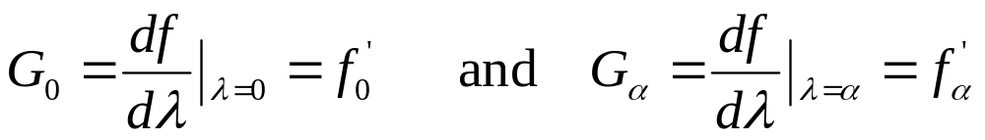
3.6 Davidon’s
Cubic Interpolation Method
  Davidon’s Cubic Interpolation Method, is generally better than Powell’s QIM, if derivatives of the objective function f(x) are easy to evaluate.
  Consider the problem: minf(x) along x=x₀+λ, where x₀ is the current point and λ is an unknown parameter. Let f₀=f(x₀) and f_{α}=f(x₀+α) where α is a given value of λ.
  Suppose we know:
  Here G₀ < 0 is assumed. To cover the case G₀ > 0, i.e., minimum to the left, use f_{α} = f(x₀-α).

Slide 32
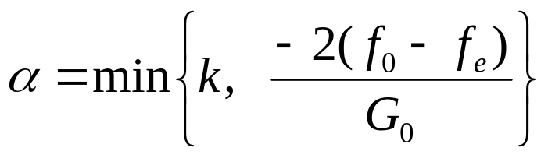
3.6 Davidon’s CIM (II)
  Minimization occurs in 3 steps:
  (a) Order of magnitude of λ_{m} - the minimized value of λ - is established;
  (b) Upper and lower bounds are found for λ_{m};
  (c) Cubic interpolation is used for more precise bounds.
  Step (a): Initial estimation of λ_{m}:
  where: k = some representative magnitude, usually k = 2
  f_{e} = preliminary estimate of f(x₀+ λ_{m})

Slide 33
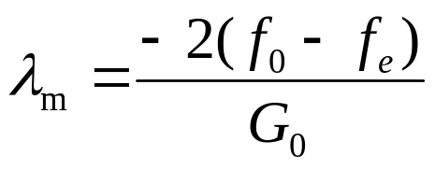
3.6 Davidon’s CIM (III)
  Note: for quadratic functions, there stands:
  where f_{e} is an exact estimate of minimum of f(x₀+ λ).
  Proof: f(x₀+ λ) = a(x₀+ λ)² + b(x₀+ λ) + c
  . . . . . .
  Step (b): Assume cubic y(λ) approximates f(x+λ), then:
  y(0) = f₀ ⋅ ⋅ ⋅ (1) y(α) = f_{α} ⋅ ⋅ ⋅ (2)
  y′(0) = G₀ ⋅ ⋅ ⋅ (3) y′(α) = G_{α} ⋅ ⋅ ⋅ (4)

Slide 34
3.6 Davidon’s CIM (IV)
  Since G₀ < 0, λ_{m} will be located between [0, α] if either G_{α} > 0 (A) or f_{α} > f₀ (B)
y(λ)
y(λ)
f_{α}
f₀
f_{α}
f₀
λ
λ
0
λ_{m}
α
0
λ_{m}
α
(A)
(B)
  If neither, then replace x+α by x+2α. Repeating if necessary, till the minimum of y(λ) is bracketed; then start the interpolation.

Slide 35
3.6 Davidon’s CIM (V)
  Step (c): Cubic interpolation formula:
  Assume y(λ) = f₀ + G₀ λ + y₂λ² + y₃λ³ ⋅ ⋅ ⋅ (5)
  ⋅ ⋅ ⋅ ⋅ ⋅ ⋅
  ⇒ y₂ = -(G₀+Z)/α
  y₃ = (G₀+G_{α}+2Z)/3α²
  where Z = G₀+G_{α}+3(f₀-f_{α})/α
  ⋅ ⋅ ⋅ ⋅ ⋅ ⋅
  ⇒ λ_{m} / α = (G₀+Z+w)/(G₀+G_{α}+2Z) = (Z+w-G₀)/(G_{α}+2w-G₀)
  where w = (Z²-G₀G_{α})^{1/2}

Slide 36
3.6 Algorithm for Davidon’s CIM
  1. Calculate f₀ = f(x₀) and G₀ = f(x₀); check that G₀ < 0; choose k and f_{e} and determine α (normally k = 2).
  2. Evaluate f_{α} = f(x₀+α) and G_{α} = f ′(x₀+α).
  3. If G_{α} > 0 or f_{α} > f₀ , go to Step 5; otherwise go to Step 4.
  4. Replace α by 2α, evaluate new f_{α} and G_{α}, back to Step 3.
  5. Interpolate on the interval [0, α] for λ_{m} using the cubic interpolation formula;
  6. Return to Step 5 to repeat the interpolation on smaller interval [0, λ_{m}] OR [λ_{m}, α] if
  f ′(x₀+λ_{m}) ≥ 0 or f(x₀+λ_{m}) > f(x₀) OR f ′(x₀+λ_{m}) < 0.
  7. Stop if λ_{m} is within ε distance to the endpoints or the length of the interval is less than ε.

Slide 37
3.6 Example for Davidon’s CIM
Ex 3-5: Use Davidon’s CIM to find the minimum point of f(x) = x⁴-4x+1, given x₀ = 0, ε = 0.05.
Sol: (1) x₀ = 0, f₀ = 1, G₀ = -4, α = min{k, -2(f₀ - f_{e})/G₀} = 1 or 2
(2) choose α = 2 ⇒ f_{α} = 9, G_{α} = 28
(3) λ_{m}/α = (ω - G₀ + z)/(G_{α} - G₀ + 2ω) ⇒
z = 3(f₀ - f_{α} )/α + G₀ + G_{α} = 12, ω = (z² - G₀G_{α})^{1/2} = 16
⇒ λ_{m} = 1
(4) f′ (x₀+λ_{m}) = f′ (0+1) = 0 ⇒ new interval is [0, 1]
⇒ α = 1 ⇒ f_{α} = -2, G_{α} = 0 ⇒ z = 5, ω = 5
⇒ λ_{m} = 1 as before! ⇒ x* = x₀+λ_{m} = 1, f(x*) = -2

Slide 38
Chapter 4 Unconstrained
Optimization Methods
  The kernel of unconstrained optimization methods is the descent algorithm. Descent algorithms have uniform iteration formulae. The key problems are how to choose the search direction and develop the 1-D search along these directions.
  This chapter mainly covers the methods that construct the search directions by utilizing the information of the first-order and second-order derivatives of the objective function, including Steepest Descent Method, Newton Method, Quasi-Newton Method, and Conjugate Gradient Method.

Slide 39
4.1 Steepest Descent Method (SDM)
  In this method, the negative gradient direction at the iteration point is used as the searching direction, since the negative gradient direction is the direction that the function value decreases most rapidly.
  Iteration Formula for SDM:
  S_{k} = -∇f(X_{k}) = -g_{k}, X_{k+1} = X_{k} + α_{k}S_{k}
  or X_{k+1} = X_{k} - α_{k}∇f(X_{k}) = X_{k} - α_{k} g_{k}
  where α_{k} is determined by 1-D search:
  f(X_{k} + α_{k}S_{k}) = min f(X_{k} + αS_{k})
  To obtain the optimal value of the step length, take the derivative with respect to α (df / dα = 0):

Slide 40
4.1 Steepest Descent Method (II)
  [∇f(X_{k} + α_{k}S_{k})]^{T} S_{k} = [∇f(X_{k+1})]^{T} S_{k} = -g_{k+1}^{T}g_{k}= 0
  ⇒ g_{k+1}^{T}g_{k}= 0 or s_{k+1}^{T}s_{k}= 0
  where, g_{k} = ∇f(X_{k}) is the gradient at point X_{k}.
  This represents that the gradients of two consecutive iteration points are orthogonal, i.e., these two searching directions are perpendicular to each other.
  When using SDM to generate iteration points, the path of approaching the minimum point is a step type curve. The closer to the minimum point, the step is smaller, and the approaching speed gets slower, as shown below:

Slide 41
4.1.2 Algorithm for SDM
  1. Initial estimate X₀ and convergence accuracy ε > 0 are given; Set k = 0.
  2. Calculate the gradient at this point and construct the search direction S_{k} = -∇f(X_{k});
  3. Use the 1-D search to find the new iteration point:
  f(X_{k} + α_{k}S_{k}) = min f(X_{k} + αS_{k})
  X_{k+1} = X_{k} + α_{k}S_{k}
  4. Convergence judgment: if ||∇f(X_{k+1})|| ≤ ε, then the search can be terminated and the optimal solution is X∗ = X_{k+1}; otherwise let k=k+1, go to Step 2 continue;

Slide 42
4.1.3 Further Discussion on SDM
  Utilize SDM to solve problems, quite a lot iterations are needed to get an approximation of the optimal solution, which is attributed to the characteristics of the gradient.
  The gradient is the description of the local variation of the function around certain point. Along the negative gradient direction, the function value decrease most rapidly. However, outside the neighborhood of this point, the function values may not decrease.
  Use the negative gradient direction as the searching direction, every iteration is able to make the function values decrease rapidly, from the local point of view; But from the global point of view, the path to the minimum point is not the best way. It can be proven that SDM only has a linear convergence rate.

Slide 43
4.1.4 Example for SDM
  Ex.4-1: Solve the following problem using SDM.
  min f(X) = x₁² + 2x₂² - 2x₁x₂ - 4x₁
Given X₀ = [1, 1]^{T}, ε = 0.1.
Sol: ∇f(X) = [2x₁ - 2x₂ - 4, -2x₁ + 2x₂]^{T}
(1) ∇f(X₀) = [-4, 2]^{T} ⇒ s₀ = [4, -2]^{T} ⇒ X₁ = [1+4α₀, 1-2α₀]^{T}
df(X₁) /dα₀ = 0 ⇒ α₀ = 1/4 ⇒ X₁ = [2, 0.5]^{T} ⇒ ∇f(X₁) = [-1, -2]^{T}
(2) s₁ = [1, 2]^{T} ⇒ X₂ = [2+α₁, 0.5+2α₁]^{T}
df(X₂) /dα₁ = 0 ⇒ α₁ = 1/2 ⇒ X₂ = [2.5, 1.5]^{T} ⇒ ∇f(X₂) = [-2, 1]^{T}
……
See graphic illustration.

Slide 44

About Sir Isaac Newton
Isaac Newton (1642--1727) was an English physicist, mathematician, astronomer, natural philosopher, alchemist, and theologian, has been "considered by many to be the greatest and most influential scientist who ever lived."
Godfrey Kneller’s 1689 Portrait of Isaac Newton (age 46)

Slide 45
Newton’s major achievements:
His monograph Philosophiae Naturalis Principia Mathematica, published in 1687 (written in Latin), lays the foundations for most of classical mechanics. In this work, Newton described universal gravitation and the three laws of motion, which dominated the scientific view of the physical universe for the next three centuries.
Newton built the first practical reflecting telescope and developed a theory of color based on the observation that a prism decomposes white light into the many colors that form the visible spectrum.
In mathematics, Newton shares the credit with Gottfried Leibniz for the development of differential and integral calculus. He also demonstrated the generalized binomial theorem, developed Newton's method for approximating the roots of a function, and contributed to the study of power series.

Slide 46
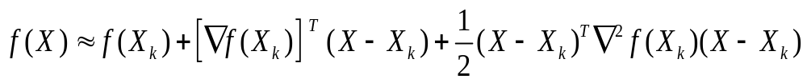
4.2 Newton’s Method
  Newton’s Method is a classic optimization method. Its search direction is constructed by utilizing the information of the negative gradient and the Hessian matrix of the function. This direction is called the Newton Direction.
  Newton’s method is derived upon the base of the Taylor’s expansion for functions with multiple variables. Expand f(X) at the current iteration point X_{k} to the second order approximation:

Slide 47
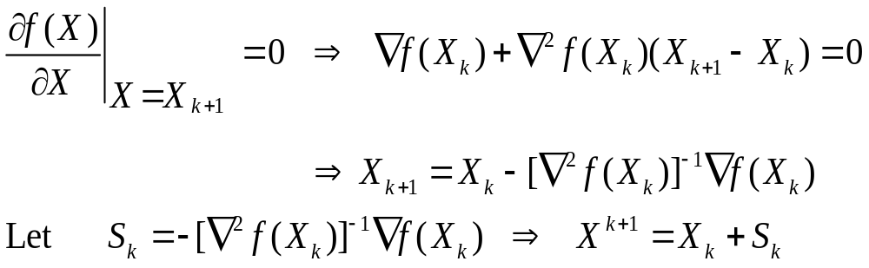
4.2.1 Newton’s Method
  It’s the iteration formula for Newton’s method, where
  S_{k} = -[∇²f(X_{k})]⁻¹∇f(X_{k})
  is called Newton’s Direction.
  Comparing with the generalized iteration formula for descent algorithms (X_{k+1} = X_{k} + α_{k}S_{k}), this formula has no step length α_{k}, or say α_{k} = 1, which means there is no need for 1-D search in basic Newton’s method.

Slide 48
4.2.1 Newton’s Method (II)
  For the positive definite quadratic function (PDQF), the second-order Taylor expansion is itself, so the X_{k+1} obtained via Newton’s method is the exact minimum point of the objective function. Hence, using the basic Newton’s method for the PDQF, any initial starting point can approach to the minimum point quickly, as long as it follows the Newton’s direction.
  For nonlinear functions with positive definite Hessians, the second-order Taylor expansion is an approximation to the objective function. Thus the X_{k+1} acquired by Newton’s method is an approximate minimum point. Use this point as the starting point for the next iteration can accelerate the approaching to the minimum point.
  For general nonlinear functions, if their Hessians are not positive definite, then the Newton’s Method may not be applicable for these functions.

Slide 49
4.2.3 Algorithm for Newton’s Method
  1. Initial estimate X₀ and convergence accuracy ε > 0 are given, set k = 0;
  2. Calculate the gradient, the Hessian and its inverse at point X_{k};
  3. Construct Newton’s direction: S_{k} = -[∇²f(X_{k})]⁻¹∇f(X_{k});
  4. Develop the 1-D search along the direction S_{k} to obtain the step length α_{k} and the next iteration point X_{k+1} = X_{k} + α_{k}S_{k};
  5. Convergence Judgement: if ||∇f(X_{k+1})|| ≤ ε, the search can be terminated and the optimal solution is X* = X_{k+1}, otherwise, let k = k+1 and return to Step 2 and continue.

Slide 50
4.2.4 Examples for Newton’s Method
  Ex 4-2: Use Newton’s Method to solve
  min f(X) = x₁² + 2x₂² - 2x₁x₂ - 4x₁
Given X₀ = [1, 1]^{T}, ε = 0.1 .
Sol: ∇f(X) = [2x₁ - 2x₂ - 4, -2x₁ + 2x₂]^{T} , ∇²f(X) is P. D.
(1) ∇f(X₀) = [-4, 2]^{T} , [∇²f(X)]⁻¹ = ……
⇒ s₀ = -[∇²f(X)]⁻¹∇f(X₀) = [3, 1]^{T}
⇒ X₁ = X₀ + s₀ = [4, 2]^{T}
⇒ ∇f(X₁) = [0, 0]^{T}
⇒ X* = X₁ = [4, 2]^{T} ⇒ f(X*) = -8

Slide 51
4.3 Quasi-Newton’s Method
  Quasi-Newton Method is the modification of Newton’s method. The search directions of this method are generated in a recursive way and approach to Newton’s direction eventually, without calculating the Hessian and its inverse of the function. It can be proven that Quasi-Newton Method has the superlinear convergence rate.
  Use the Taylor’s expansion, we can get:
  y_{k} = G_{k} s_{k} or s_{k} = G_{k}⁻¹y_{k}
  where y_{k} = ∇f(X_{k+1}) - ∇f(X_{k}) = g_{k+1} - g_{k}
  s_{k} = X_{k+1} - X_{k} G_{k} = ∇²f(X_{k})

Slide 52
4.3 Quasi-Newton’s Method (II)
  Previous discussion has shown that the Hessian G_{k} can’t be ensured to be positive definite at every iteration. Thus we may use a positive definite and symmetric matrix H_{k} to approximate G_{k}⁻¹, and update H_{k} with H_{k+1} after each iteration, to make it closer to G_{k}⁻¹.
  Hence, one can have s_{k} = H_{k+1} y_{k}
  This is called “Quasi-Newton Condition”.
  Q: How to update H_{k}?
  Updating Formula:
  H_{k+1} = H_{k} + ΔH_{k}
  where, ΔH_{k} is called the updating matrix.

Slide 53
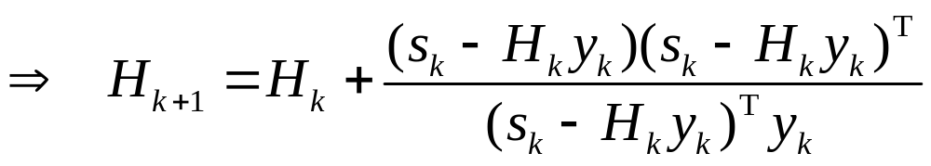
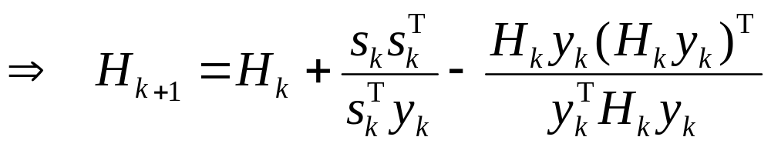
4.3.1 Updating Formulae
  There are two ways to obtain the updating matrix ΔH_{k}, known as “Rank One Correction” and “Rank Two Correction” .
  Rank One Correction:
  H_{k+1} = H_{k} + auu^{T}
  Rank Two Correction:
  H_{k+1} = H_{k} + auu^{T}+ bvv^{T}

Slide 54
4.3.2 Algorithm for
Quasi-Newton’s Method
  1. X₀, H₀ (usually H₀=I) and convergence accuracy ε>0 are given.
  2. Set k = 0 and compute g_{k} = ∇f(X_{k}).
  3. Choose p_{k} = -H_{k} g_{k} as the search direction.
  4. Develop 1-D search and determine the optimal step length α_{k}, identify the new iteration point X_{k+1} = X_{k}+α_{k}p_{k} .
  5. Convergence Judgement: if ||∇f(X_{k+1})|| ≤ ε, search can be terminated and the optimal solution is X*=X_{k+1}; otherwise continue searching.
  6. Update H_{k} to H_{k+1}: H_{k+1} = H_{k} + ΔH_{k}.
  7. let k=k+1, return to Step 2.

Slide 55
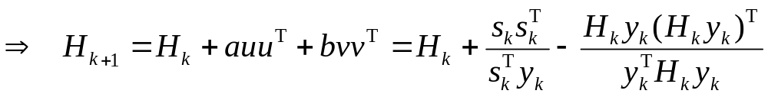
4.3.3 DFP Algorithm
  The algorithm using above “Rank Two Correction” updating formula is called DFP algorithm (Davidon-Fletcher-Powell), i.e.:
  Ex 4-3：Solve the problem via DFP algorithm.
  min f(X) = x₁² + 2x₂² - 2x₁x₂ - 4x₁
Given: X₀ = [1, 1]^{T}, ε = 0.1 .

Slide 56
4.3.4 Solution to Example 4-3
Sol: ∇f(X) = [2x₁ - 2x₂ - 4, -2x₁ + 2x₂]^{T}
(1) g₀ = ∇f(X₀) = [-4, 2]^{T} , H₀ = I ⇒ p₀ = -H₀g₀ = [4, -2]^{T}
⇒ X₁ = X₀ + α₀p₀ = [1+4α₀, 1-2α₀]^{T}
df(X₁)/dα₀ = 0 ⇒ α₀ = 1/4 ⇒ X₁ = [2, 0.5]^{T} ⇒ ∇f(X₁) = [-1, -2]^{T}
(2) H₁ = H₀ + s₀s₀^{T}/ s₀^{T}y₀ – (H₀y₀)(H₀y₀)^{T}/ y₀^{T}H₀y₀
H₀ = I, s₀ = X₁ – X₀ = [1, -0.5]^{T} , y₀ = g₁ – g₀ = [3, -4]^{T}
⇒ s₀^{T}y₀ = 5, y₀^{T}y₀=25 ⇒ H₁ = [0.84, 0.38, 0.38, 0.41]
⇒ p₁ = -H₁g₁ = [1.6, 1.2]^{T}
⇒ X₂ = X₁ + α₁p₁ = [2+1.6α₁, 0.5+1.2α₁]^{T}
df(X₂)/dα₁ = 0 ⇒ α₁ = 5/4 ⇒ X₂ = [4, 2]^{T} ⇒ ∇f(X₁) = [0, 0]^{T}
⇒ X* = X₂ = [4, 2]^{T} ⇒ f(X*) = -8

Slide 57
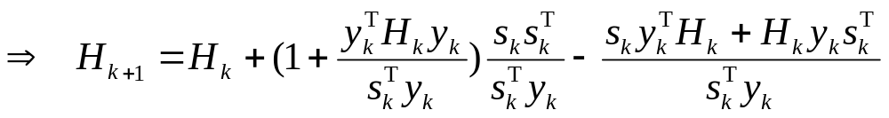
4.3.5 BFGS Algorithm
  Another well-known Rank Two Correction updating formula is BFGS formula (Broyden-Fletcher-Goldfarb-Shanna), the corresponding algorithm is called BFGS algorithm. In general, BFGS algorithm is better than DFP algorithm.
  The idea of BFGS algorithm is to use a positive definite symmetric matrix B_{k} to approximate G_{k} , NOT G_{k}⁻¹.
  Hence, the Quasi-Newton Condition becomes:
  y_{k} = B_{k+1}s_{k} where B_{k}= H_{k}⁻¹
  Rank Two Correction becomes: B_{k+1}=B_{k}+auu^{T}+bvv^{T}

Slide 58
4.4 Conjugate Gradient Method
  Conjugate Gradient Method is an unconstrained optimization method using the conjugate directions as the search directions.
  Conjugate Direction:
  H is a symmetric positive definite matrix. If there are a set of nonzero vectors s₁, s₂, …, s_{n} satisfying:
  s_{i}^{T}Hs_{j} = 0 (i ≠ j)
  Then these set of vectors are said to be conjugate with respect to H, and they are called as a set of conjugate vectors / directions of H.
  When H is the unit matrix I, there has: s_{i}^{T}s_{j} = 0 (i ≠ j). Vectors s_{i} (i = 1,…, n) are called orthogonal to each other.
  Conjugation is the generalization of orthogonality and orthogonality is a special case of conjugation.

Slide 59
4.4.1 Properties of Conjugate Directions
  Properties of Conjugate Directions:
  (1) If s_{i} (i = 1, 2,…, n) are the conjugate directions of positive definite symmetric H, then s_{i} (i = 1, 2,…, n) are linear independent.
  (2) Positive definite symmetric matrix H = (a_{ij})_{n×n} has no more than n different conjugate directions.
  (3) If s_{i} (i = 1, 2,…, n) are n vectors conjugate with respect to H, then for PDQFs, starting from any initial point and do linear search along these n directions, at most n iterations are needed to reach the minimum point of the object functions.
  Prove (1)

Slide 60
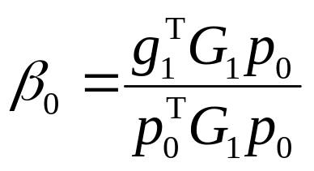
4.4.2 Generation of Conjugate Directions
  Generation procedures of conjugate directions:
  1. Given X₀, let p₀= -g₀ = -∇f(X₀), calculate G₀ = ∇²f(X₀);
  2. minf(X₀ + αp₀) ⇒ α₀ ⇒ X₁ = X₀+α₀ p₀ ⇒ g₁ = -∇f(X₁), G₁ = ∇²f(X₁);
  3. At X₁, set search direction p₁= -g₁ + β₀ p₀, β₀ can be determined by properties of the conjugate directions:
  at point X₁, vectors p₀, p₁ are conjugate with respect to symmetric positive definite matrix G₁ ⇒
  p₁^{T}G₁p₀=0 ⇒ (-g₁+β₀ p₀)^{T}G₁p₀=0 ⇒

Slide 61
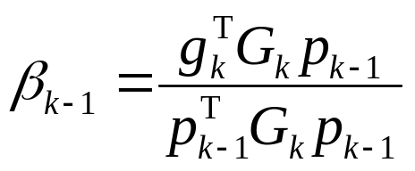
4.4.2 Generation of CDs (Cont’d)
  Similarly, at point X_{k}, the search direction is expressed as p_{k} = -g_{k}+β_{k-1} p_{k-1}, where β_{k-1} can be determined by the conjugate relationship among the search directions:
  ⇒ X_{k+1}= X_{k} + α_{k}p_{k}, where min f(X_{k} + α_{k}p_{k}) ⇒ α_{k}
  …
  until k = n-1.
  In this way, n conjugate directions p₀, p₁, …, p_{n-1} can be identified.

Slide 62
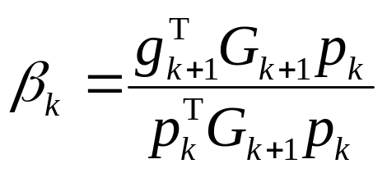
4.4.3 Algorithm for CGM
  1. Given X₀ and convergence accuracy ε > 0, calculate p₀ = -g₀ = -∇f(X₀), G₀ = ∇²f(X₀); Set k = 0;
  2. Compute α_{k}: f(X_{k} + α_{k}p_{k}) = min f(X_{k} + α p_{k}) ⇒ α_{k}
  3. X_{k+1} = X_{k} +α_{k} p_{k} ⇒ g_{k+1} = ∇f(X_{k+1}), G_{k+1} = ∇²f(X_{k+1});
  4. Convergence Judgment: if ||∇f(X_{k+1})|| ≤ ε, terminate the algorithm, and the optimal solution is X* = X_{k+1}; otherwise continue searching;
  5. p_{k+1} = -g_{k+1} + β_{k} p_{k};
  6. let k = k+1,return to Step 2.

Slide 63
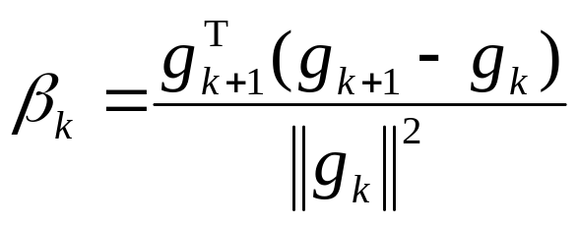
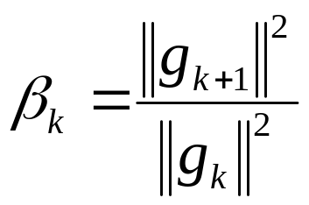
4.4.3 PRP and FR algorithms
  In the algorithm of the conjugate gradient method:
  PRP (Polyok-Ribere-Polak) algorithm:
  FR (Fletcher-Reeves) algorithm:

Slide 64
4.4.4 Further discussion on CGM
  Conjugate Gradient Method utilizes the gradients of the function to construct the conjugate directions. It has the superlinear convergence rate.
  For PDQFs with n variables, conduct 1-D search along the conjugate gradient directions, at most n iterations are needed to reach the minimum point.
  Ex 4-4: Solve the problem using FR algorithm.
  min f(X) = x₁² + 2x₂² - 2x₁x₂ - 4x₁
Given X₀ = [1, 1]^{T}, ε = 0.1 .

Slide 65
4.4.5 Solution to Example 4-4
Sol: ∇f(X) = [2x₁ - 2x₂ - 4, -2x₁ + 2x₂]^{T}
(1) g₀ = ∇f(X₀) = [-4, 2]^{T} ⇒ p₀ = -g₀ = [4, -2]^{T}
⇒ X₁ = X₀ + α₀p₀ = [1+4α₀, 1-2α₀]^{T}
df(X₁)/dα₀ = 0 ⇒ α₀ = 1/4 ⇒ X₁ = [2, 0.5]^{T} ⇒ ∇f(X₁) = [-1, -2]^{T}
(2) β₀ = g₁^{T}g₁ / g₀^{T}g₀ = 5/20 = 1/4
⇒ p₁ = -g₁ + β₀p₀ = [2, 1.5]^{T}
⇒ X₂ = X₁ + α₁p₁ = [2+2α₁, 0.5+1.5α₁]^{T}
df(X₂)/dα₁ = 0 ⇒ α₁ = 1 ⇒ X₂ = [4, 2]^{T} ⇒ ∇f(X₁) = [0, 0]^{T}
⇒ X* = X₂ = [4, 2]^{T} ⇒ f(X*) = -8

